Slide 1

Motivation for Introverts
Mohit Kedia
Content Creator/ Senior Analyst

Slide 2

Work from home
Work from home is mostly suitable for introverts.
But you can’t connect well with your colleagues while working at home .
You won’t be able to deal with politics happening in the backend.
Try to prefer work from office mostly as you will find many good leaders in the company as well who will respect introverts for their skills and attitude.

Slide 3
Comparison
Introverts have one strong quality and that is charging their batteries/energy level when they are alone or enjoy their personal space.
So never compare yourself with others as one day will come when you can become a great extrovert personality who can network well with others.
Purchasing clothes by visiting malls is much better option as you can get lucky to see a very popular person.

Slide 4
Low in Confidence
Try to drink more water because water is a liquid which doesn’t have any color. Also, it will make you look more bright which will ultimately produce more confidence.
Also, Water is adaptable to any container like glass or jug or thermus.
Confidence comes from people who motivate you, appreciate your work, train you for soft skills, respect you for your attitude and intelligence and like your social media posts. So, its actually a myth.
We all have the confidence in us. All we need is right mentor who can guide you well and train you. Try to differentiate between who is right and who is wrong as soon as possible.
Lying during the first conversation : Everyone tries to hide their greatest weakness during the first conversation which can sometimes be height or dealing with the multiple people.

Slide 5
Social Anxiety
Being around 100 people, trying to have a small talk, awkward, meaningless smiles can be a lot of work. They are mostly anxious because they respect people who respects their personal space as they charge their batteries/energy either alone or with people with whom they feel comfortable talking to. They are mostly not awkward just have low self confidence.
During festivals, Some gatherings become inevitable for them to go to. Balance is the key. Spend as much time as you need in your own personal space to recover rather than being a people pleaser all the time. But, they enjoy the festivals as much as all extroverts if they respect their personal space and don't always force them to talk.
Odd man out : They are the odd man out because they don't like to talk much in person as compared to texts or calls. But talking more doesn't matters, what matters is they need to make sure that whatever they talk should always make sense to others as that will determine the response rate of people. But you can't understand why you are not getting response in texts or calls or emails.
Mental health : Mental health is as important as physical health these days. So enjoy your life by going out on vacation or with your friends or family. You can also spend your time by watching movies, TV shows or listening to songs or playing sports or having hobbies or reading books.

Slide 6

Keeping Promises
Before signing any offer letter or joining documents , please take your time and read and understand everything as later it might be used against you.
In the corporate world, don’t go the office just to look handsome or good looking or share about your personal life which can be later used against you.
Only your work, dressing style and how you present yourself while walking matters.
To be collaborative, all you need is having empathy and responding well to criticism received from coworkers.
Entire corporate world revolves around Newtons 3rd law --- Every action has an equal and opposite reaction. Its important for survival.
So, respond firmly if you face any kind of misbehaviour or rudeness from any employee including your managers.

Slide 7
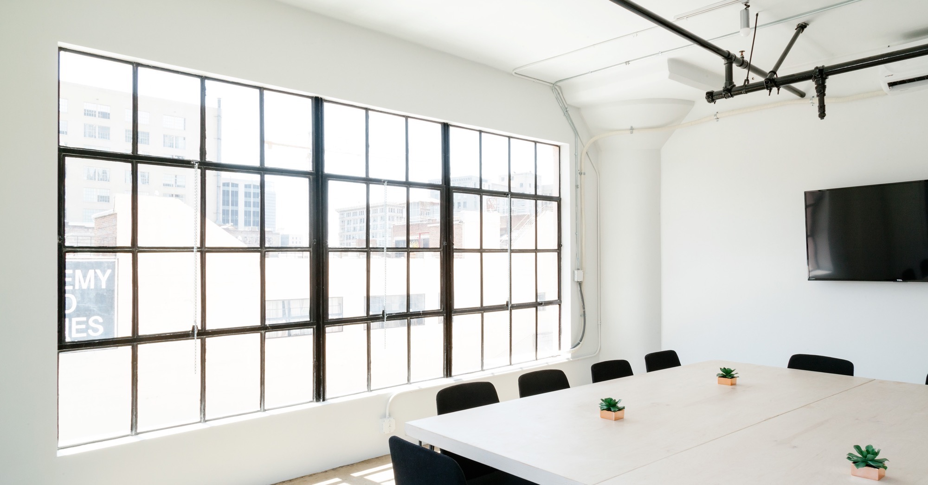
title
Public Speaking
If given an opportunity and time to prepare their thought process and speech , some introverts have the potential to deliver a great public speech.
Communication skills and eye to eye contact while speaking matters.
You can deliver a speech either by memorizing or by using a paper or a PPT.
Don’t think what people in the panel will think. Just be calm and talk freely.

Slide 8
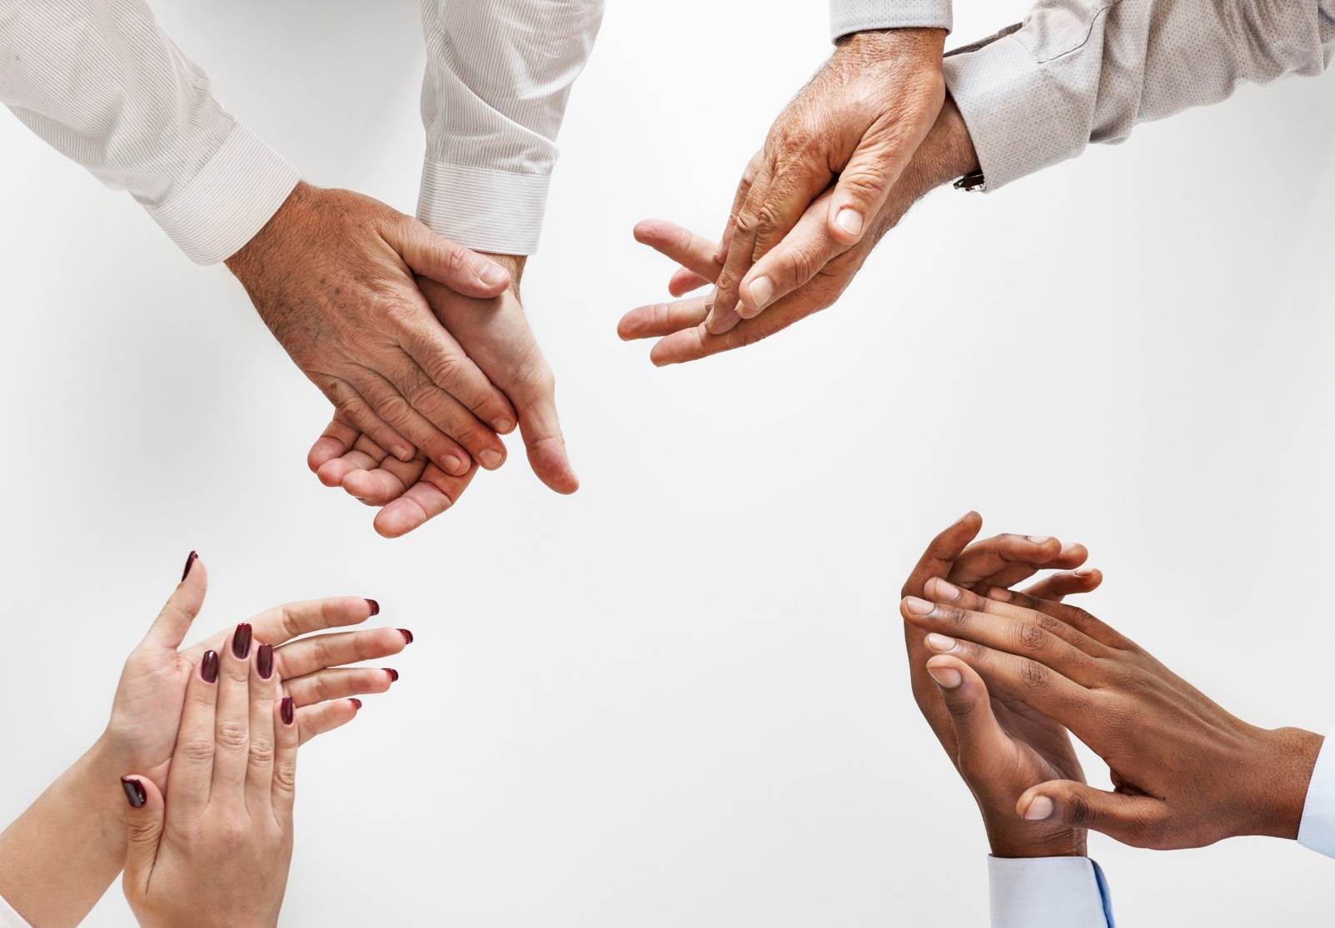




Thank You
Mohit Kedia
91-7004614723/ 95728 28378
mohitkedia5@gmail.com
https://www.linkedin.com/in/mohitkedia5/
https://github.com/MohitKedia/
https://public.tableau.com/app/profile/mohit.kedia

